Slide 1
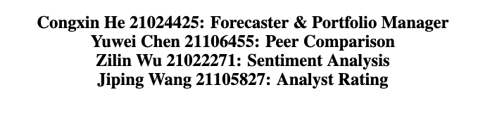
MAFS 5440 Project5:
Large Language Model - FinGPT
The Hong Kong University of Science and Technology

Slide 2
Introduction
Model Architecture
Model
Forecaster
Portfolio Manager
Peer Company Comparison
Sentiment Analysis
Analyst Rating

Slide 3
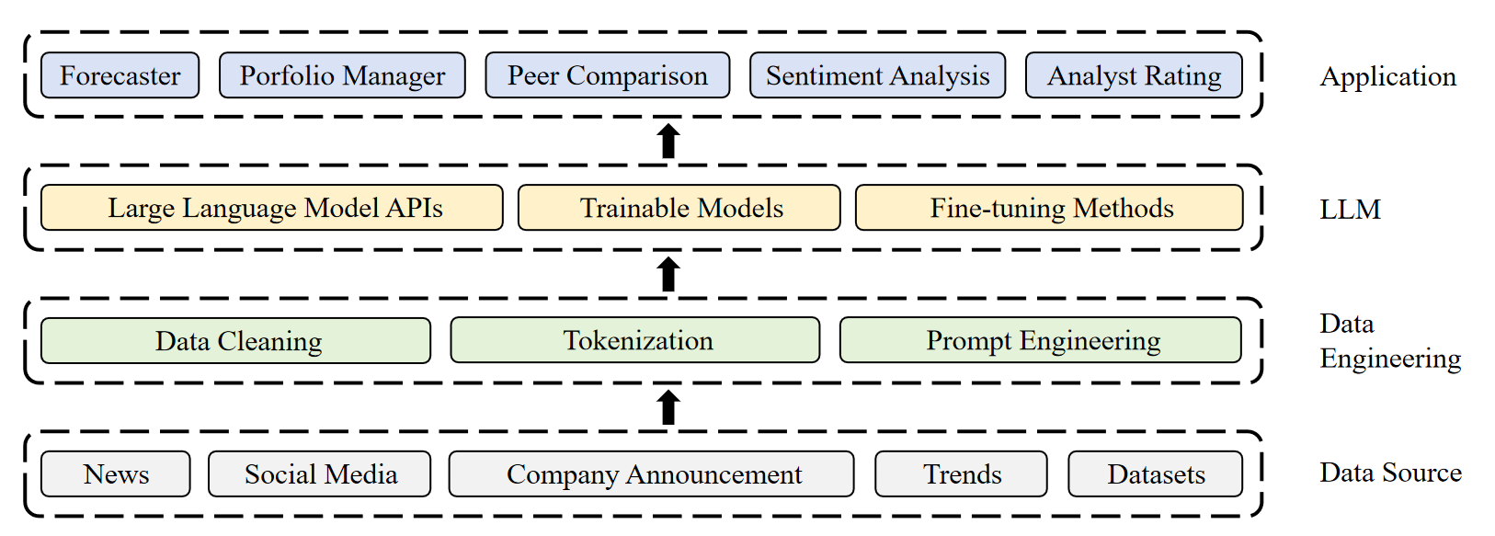
1 Model Architecture

Slide 4
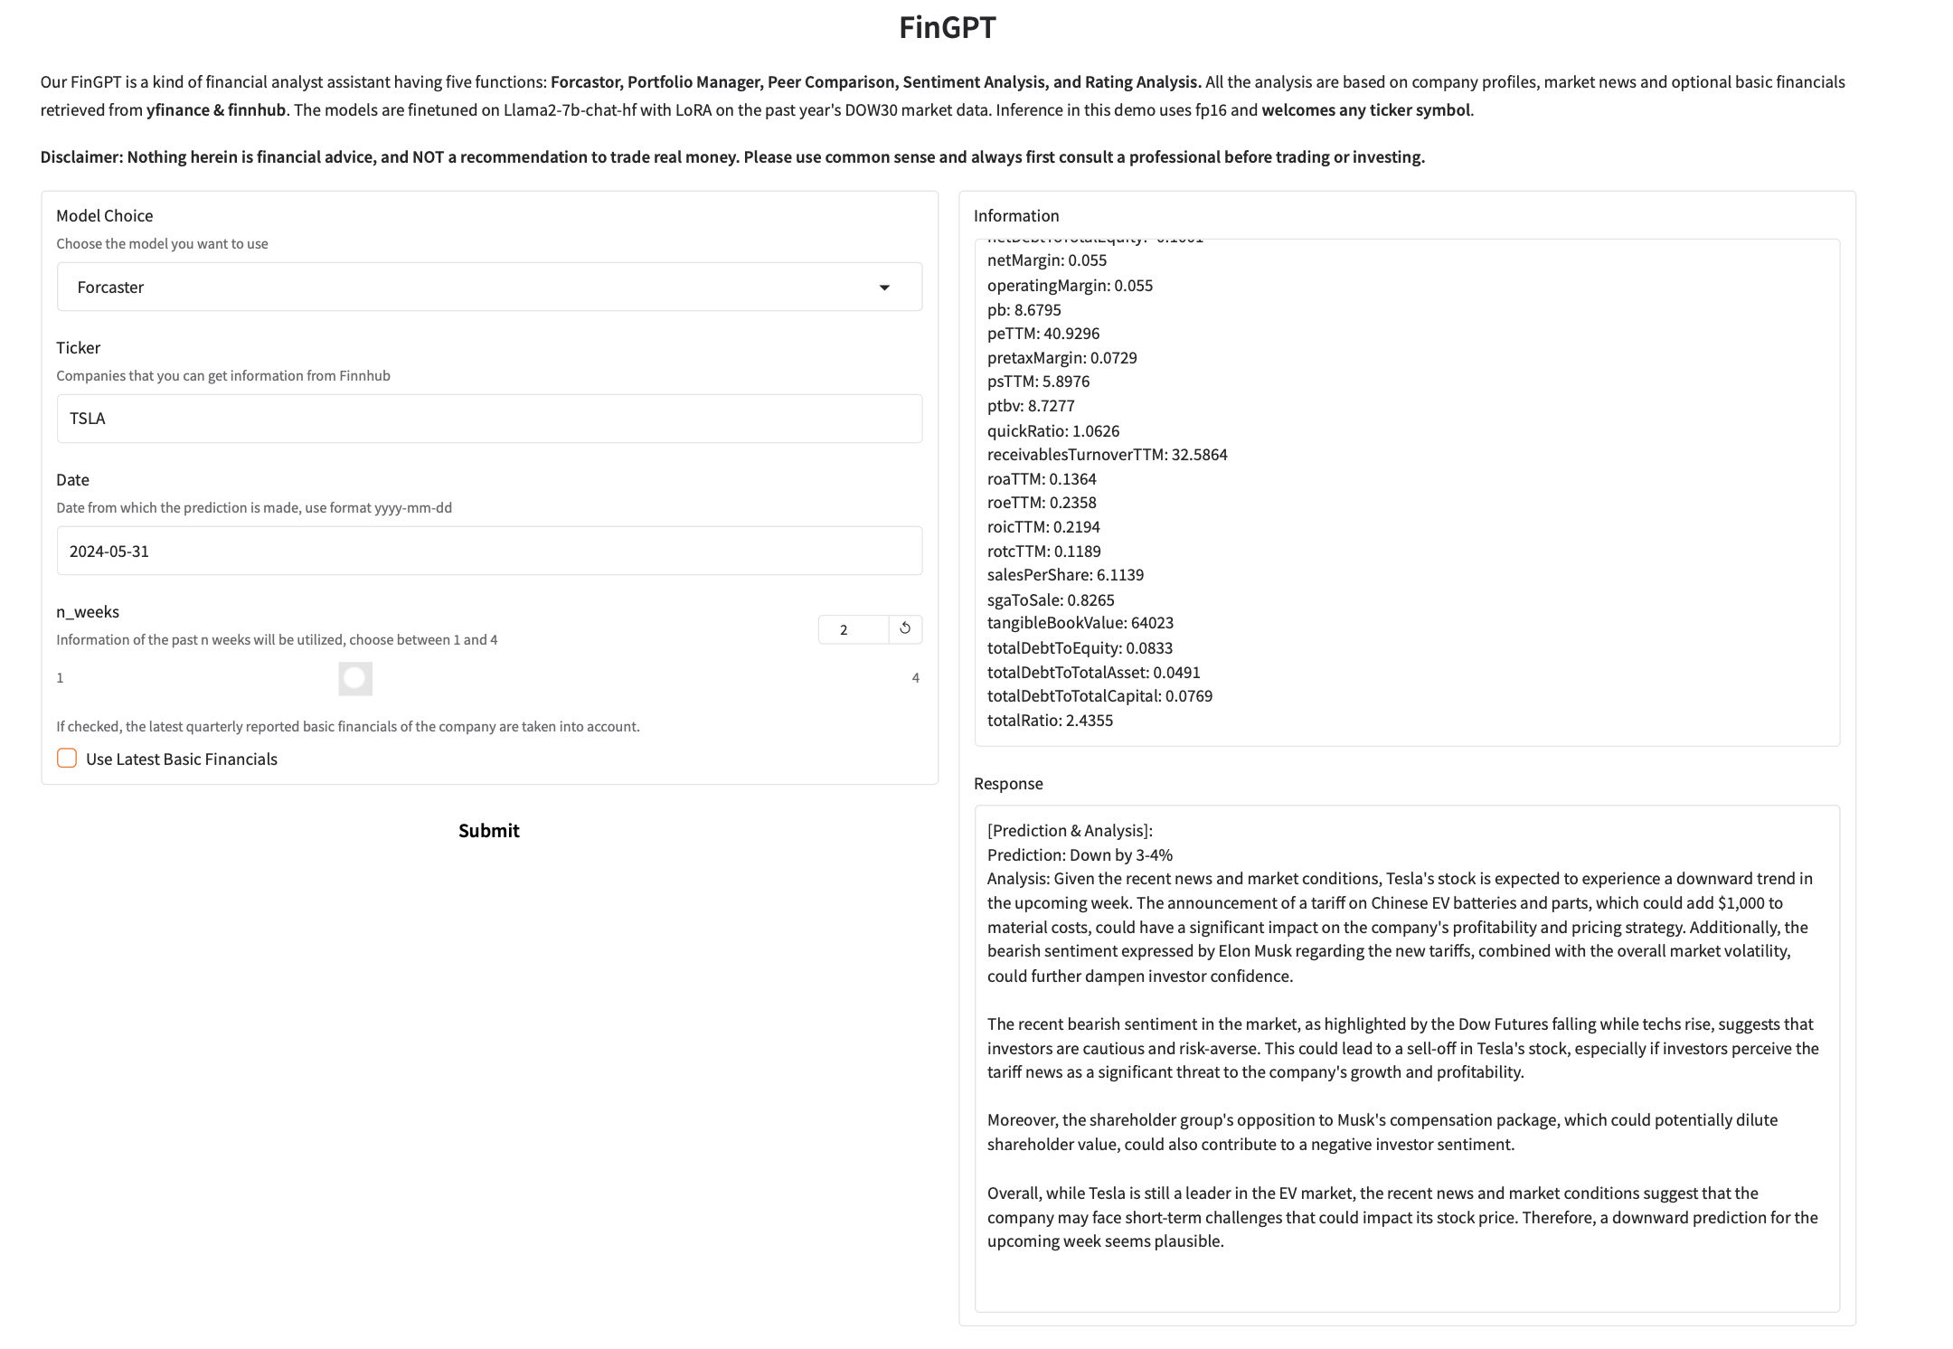
2 Model
2.1 Forecaster - Introduction
https://c50aa81e80c326e54b.gradio.live/

Slide 5
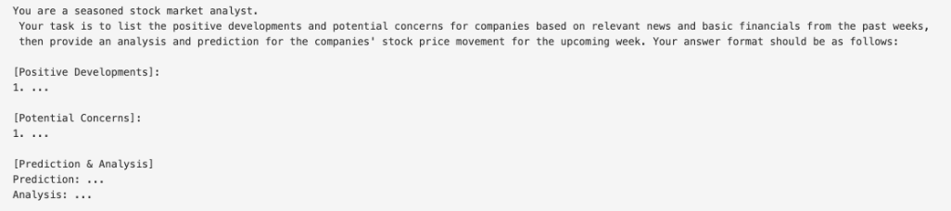
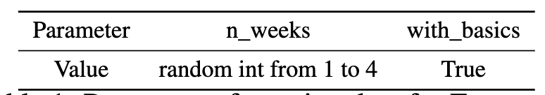
2 Model
2.1 Forecaster - Data
Step 1: Raw data
company profile, weekly return, news and basic financials.
Step 2: Prompt & Answer
Step 3: Data Parameters
loss function: mse, binary accuracy and rouge score

Slide 6
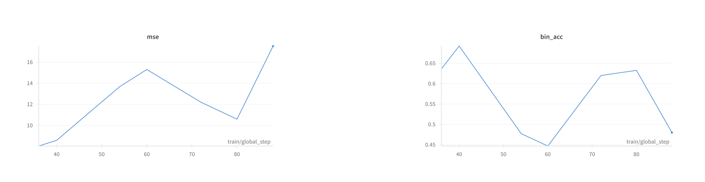
2 Model
2.1 Forecaster - Performance

Slide 7
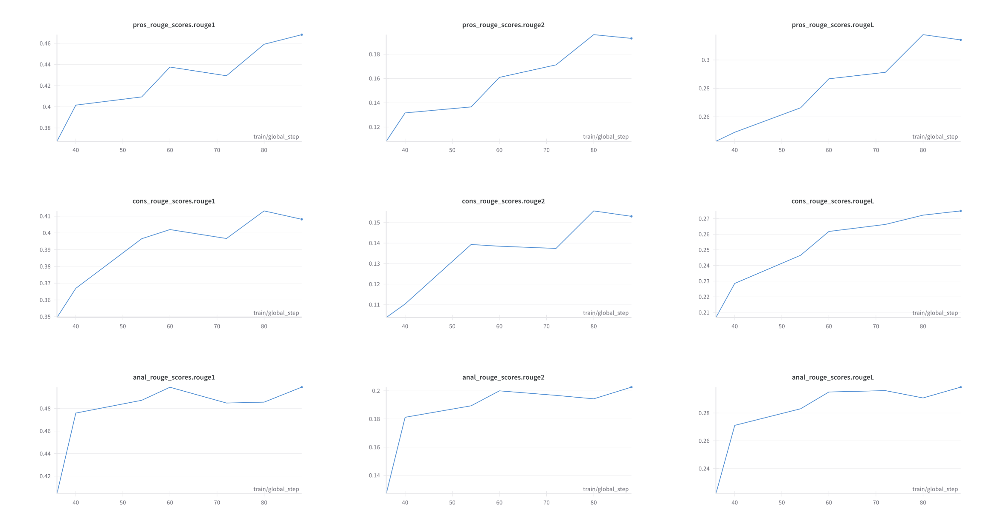
2 Model
2.1 Forecaster - Performance

Slide 8
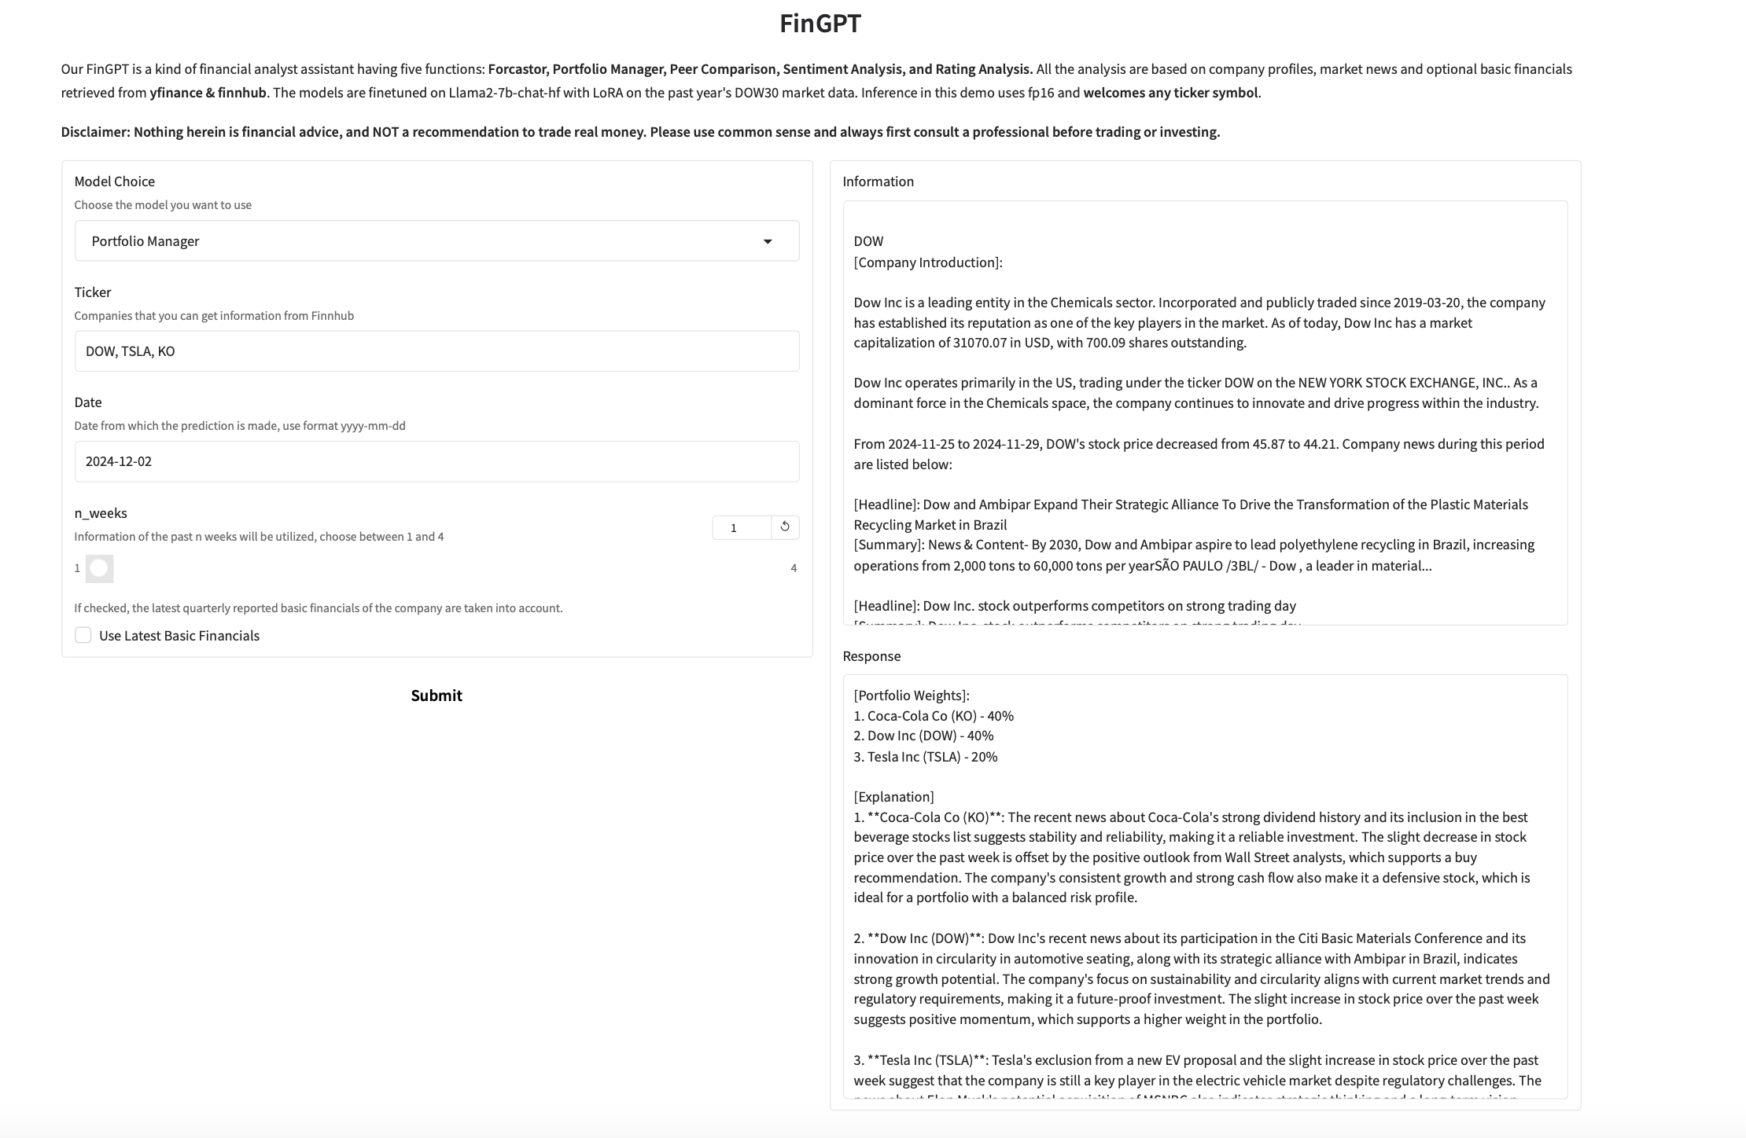
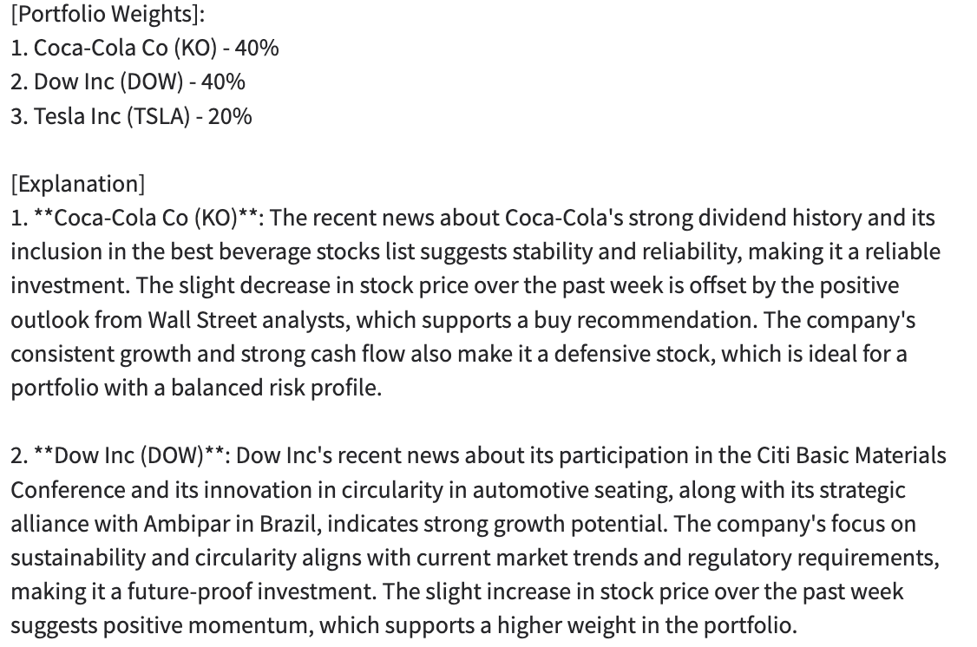
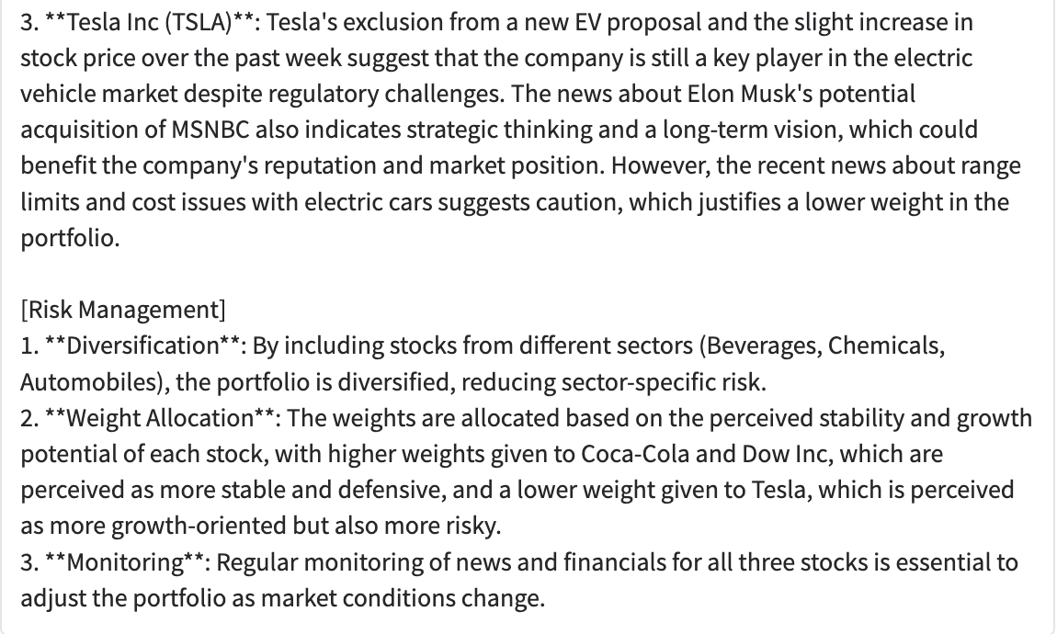
2 Model
2.2 Portfolio Manager- Introduction
https://c77b25ea2539e1740a.gradio.live/

Slide 9
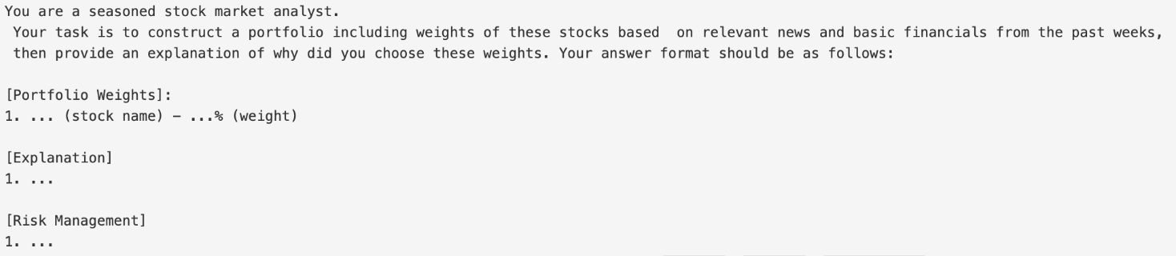
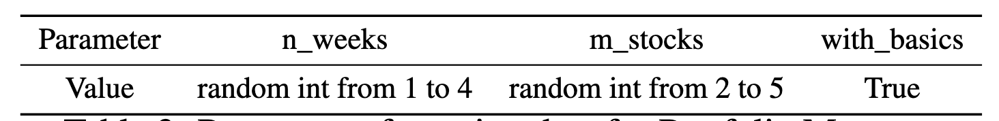
2 Model
2.2 Portfolio Manager- Data
Step 1: Raw data
company profile, weekly return, news and basic financials.
Step 2: Prompt & Answer
Step 3: Data Parameters
loss function: rouge score

Slide 10
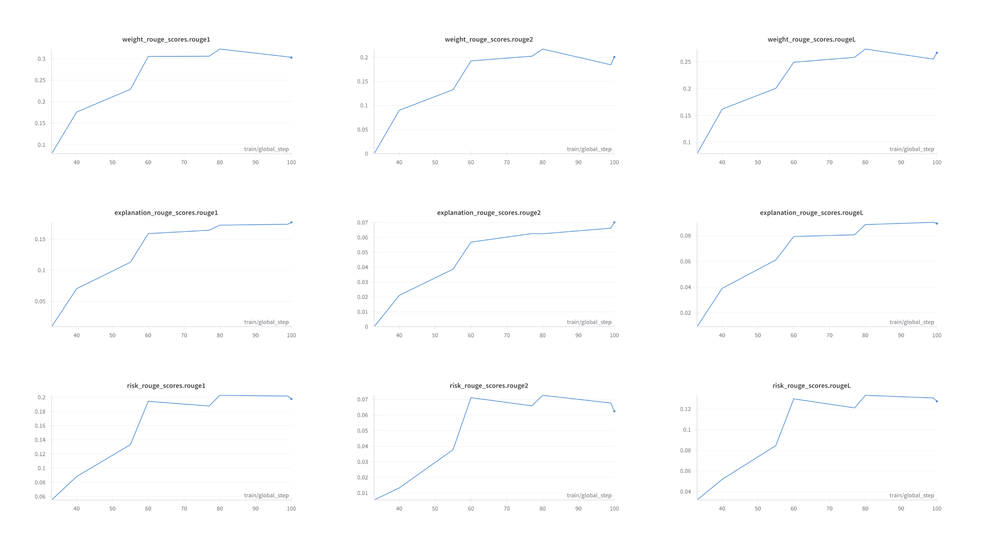
2 Model
2.2 Portfolio Manager- Performance

Slide 11
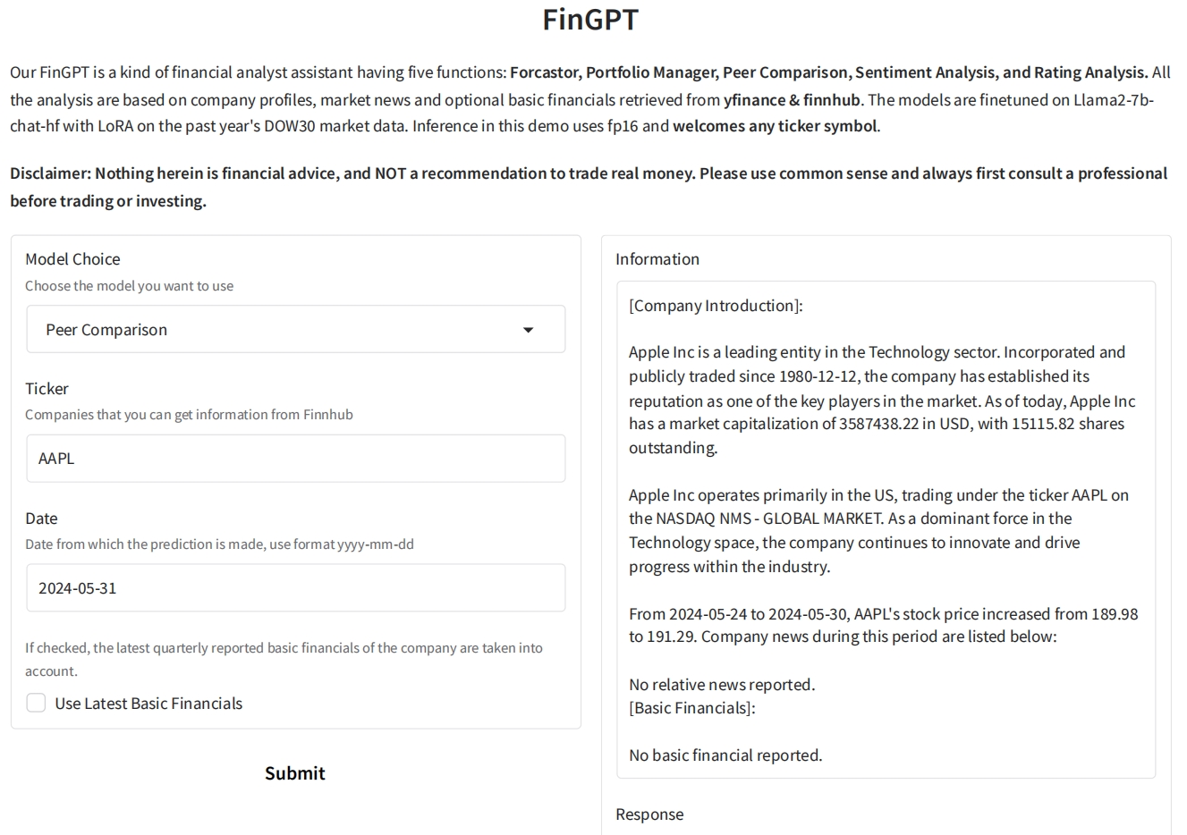
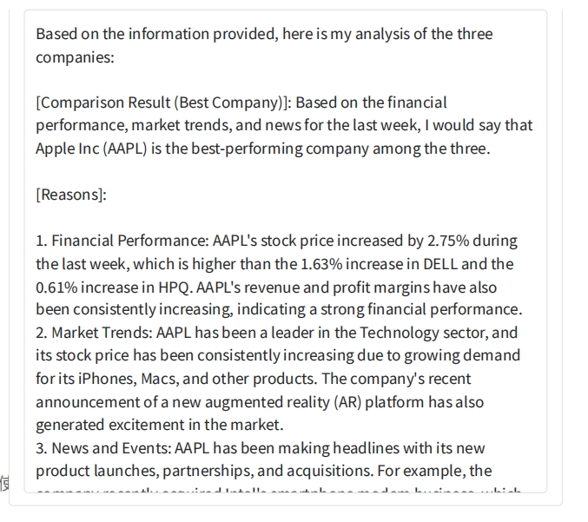
2 Model
2.3 Peer Comparison- Introduction
Demo Link:
https://c00ae2711b34061905.gradio.live/

Slide 12
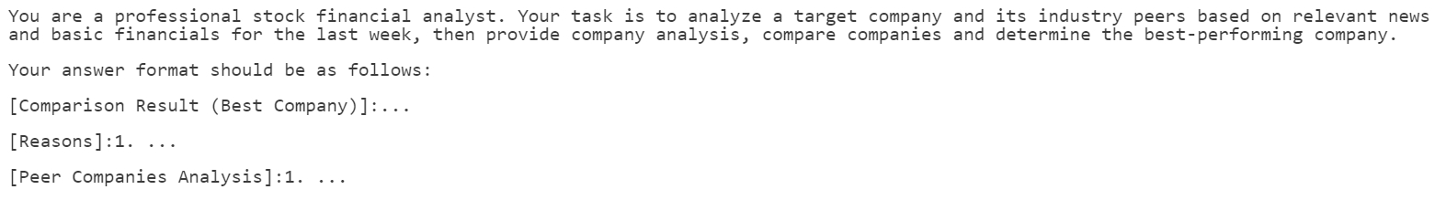
2 Model
2.3 Peer Comparison- Data
Step 1: Raw data
Company profile, market news and basic financials from Yahoo Finance and Finnhub.
Step 2: Prompt & Answer
Step 3: Data Parameters

Slide 13
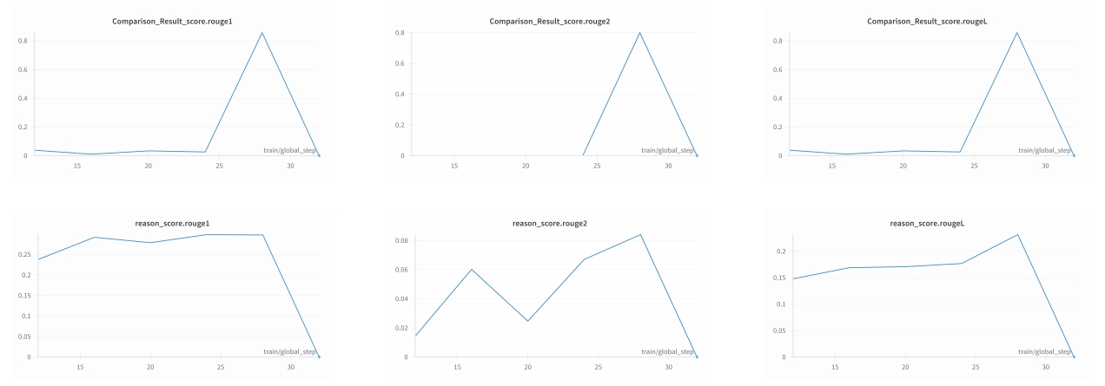
2 Model
2.3 Peer Comparison- Performance

Slide 14
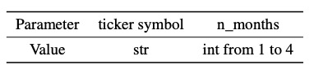
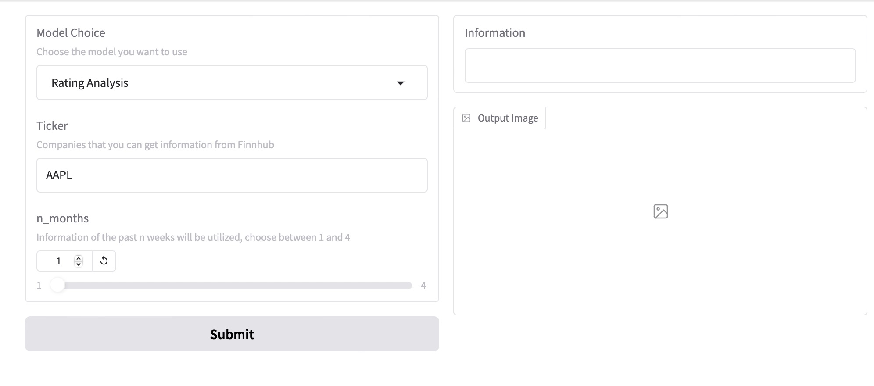
2 Model
2.5 Analyst Rating- Introduction
https://e9886ee9181267969d.gradio.live
1.Aim to show analysts' evaluations of the company
2. Presenting data over several months, it shows the trend of analysts' evaluations of the company.
3.Allows investors to better analyze the reactions of other market participants to the company.

Slide 15
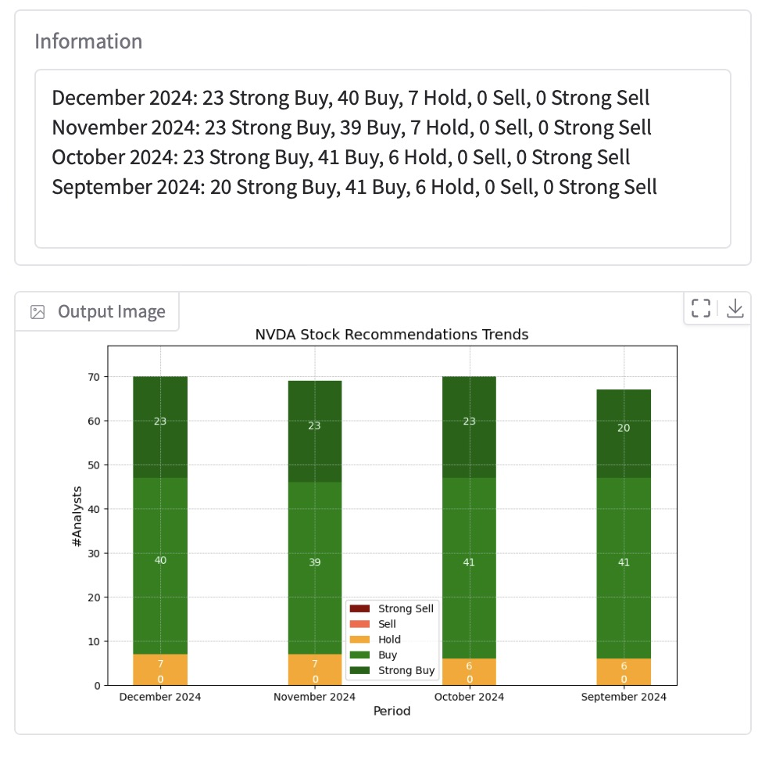
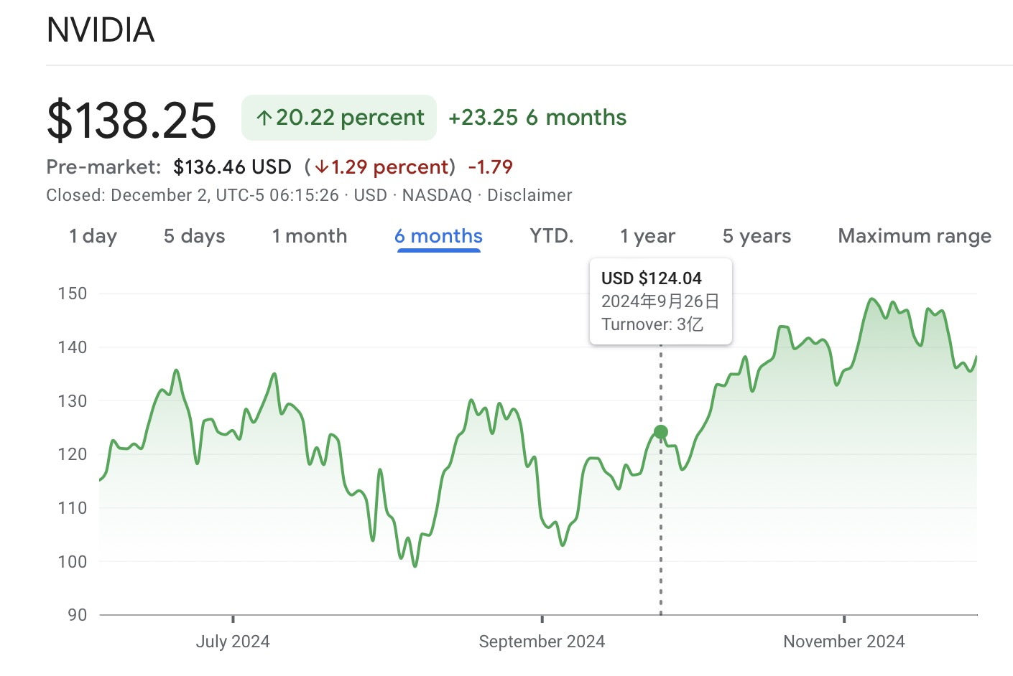
2 Model
2.5 Analyst Rating- Performance

Slide 16
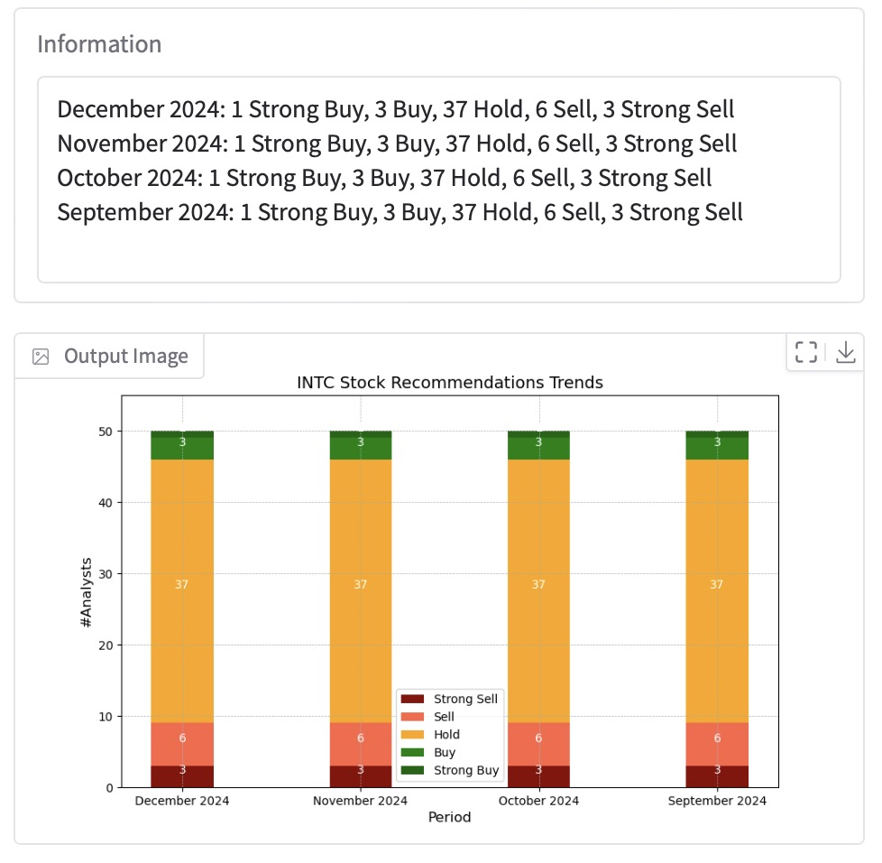
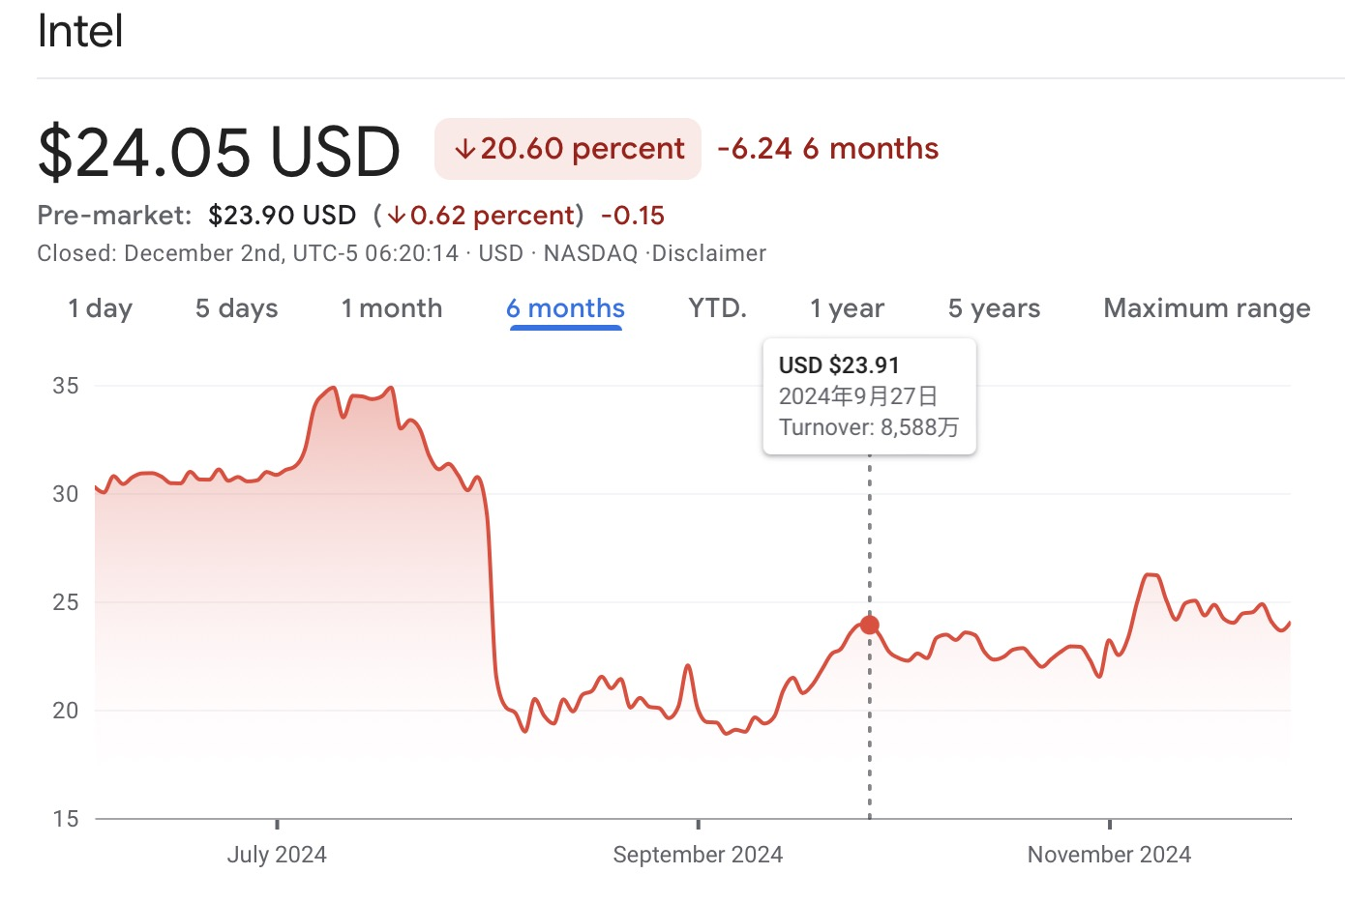
2 Model
2.5 Analyst Rating- Performance

Slide 17
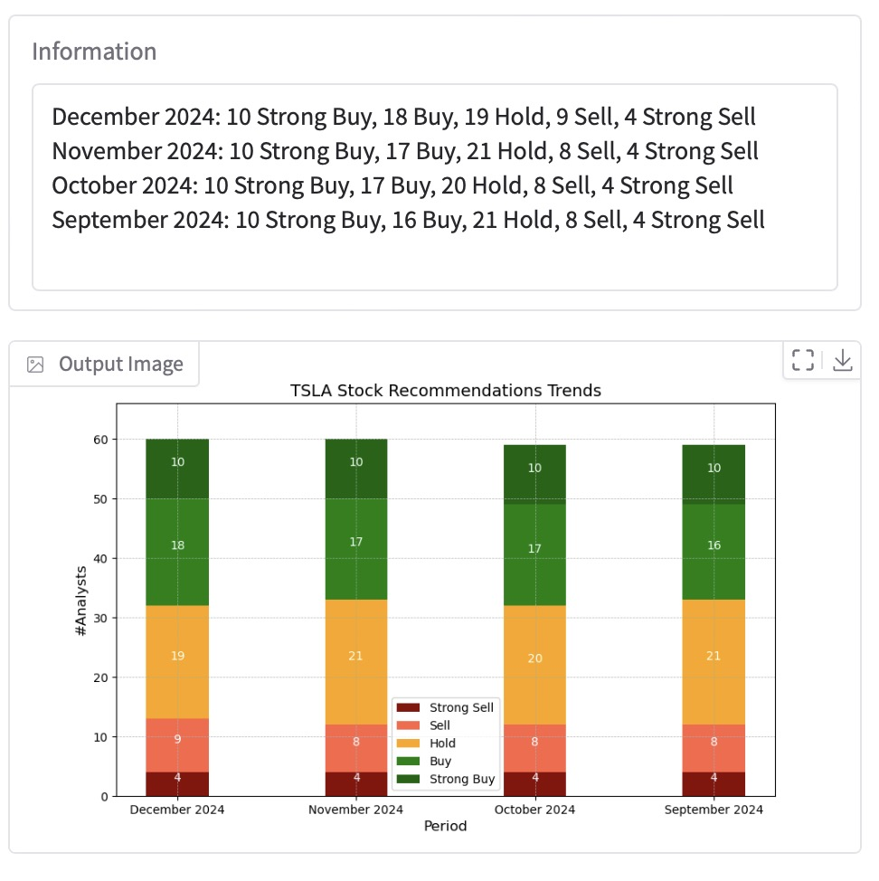
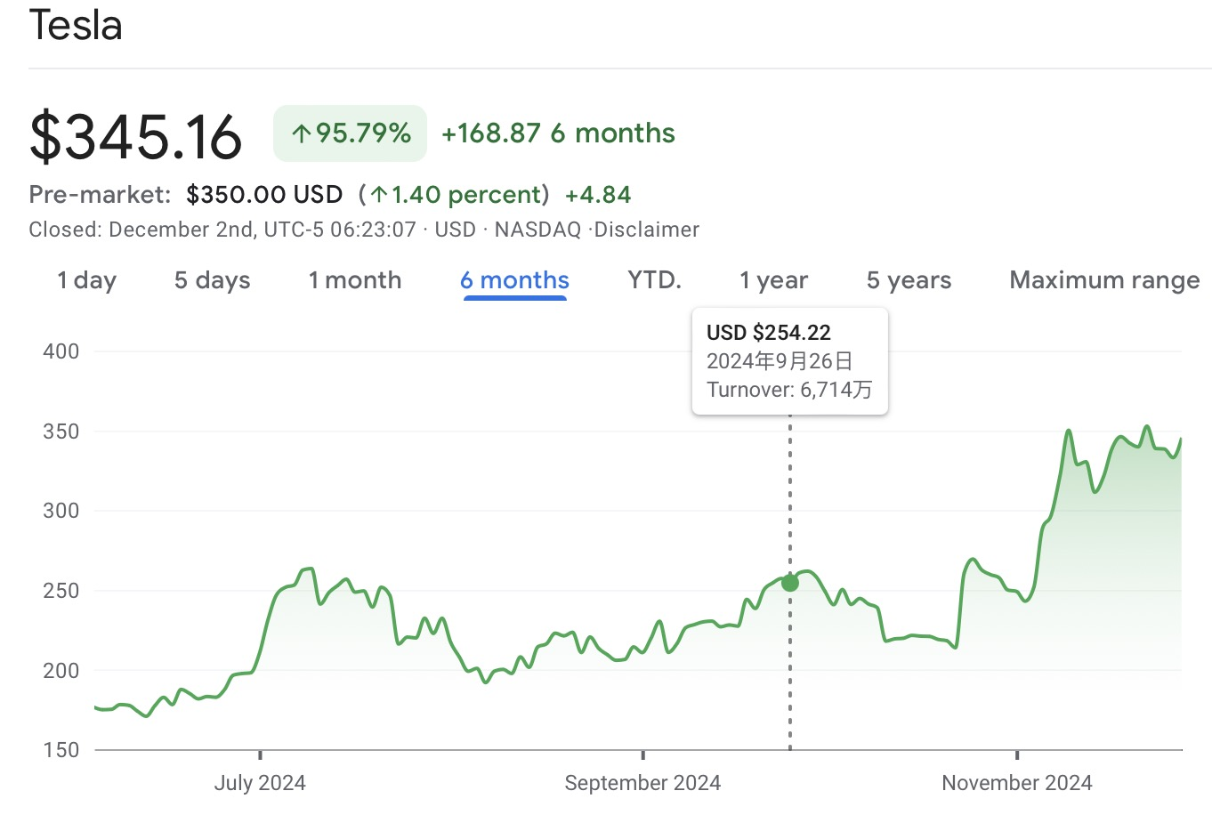
2 Model
2.5 Analyst Rating- Performance

Slide 18
THANK YOU !

